Slide 1


Developer Salary Prediction
MGMT 6203 Summer 2022
Notes:
Thomas : 1-6

Slide 2
Team 94 Composition
Lindsey Tartaglia (GTID: ltartaglia3) - Senior Analytics Consultant
Kamil Zmijewski (GTID: kzmijewski3) - Research Scientist
Shilpa G (GTID: sg306) - Machine Learning Engineer, Yelp
Neema J Kafwimi (GITD: nkafwimi3) - Data Analyst, D-tree International
Thomas Svennevik (GITD: tsvennevik3) - Data Scientist
Notes:
We are a diverse team based in Europe and Africa.

Slide 3
Problem Statement
We are a team of independent consultants seeking to find the drivers of salary differences for employees in IT development. We want to be able to make prediction models to estimate compensation for a particular skill combination, while also controlling for other relevant factors like country GDP, age, and experience.
Notes:
In this project we take on the role as a team of independent consultants working in IT development. Tech is a rapidly evolving field where we constantly have to develop our competences. So we are interested in knowing how various skills and other factors affect the salary of people working in the field. This will give us a basis to tailor the rates we charge and find the most profitable skills for us to acquire.
Old problem statement:
We are a team of independent consultants seeking to gain skills in a developer role. We need to understand what skills are required in different countries, how many years of developer skills effect salary, and the projection of salary within this career. Using the Developer Dataset from Stack overflow demand of developers within future years and which skills will come at a premium rate.

Slide 4
Data Description
Our data is based on the annual Stack Overflow Developer survey. An annual survey of programmers, software development professionals, and others associated with the computer science industry.
All survey response answers are available as datasets for each year from 2011 to 2021. Each year has different questions, some questions are similar across the years.
We create a consolidated analytical dataset that contains comparable answers across each year.
The dataset have variables representing; country of residence , GDP of country, occupation, company size, years of IT experience, programming language competencies, job satisfaction, country and compensation/salary.
Notes:
We accomplish this by mining ten years of data from the annual stack overflow survey, and extract features that are found each year into a consolidated dataset.

Slide 5
Initial Hypothesis
Main hypothesis: From a set of basic explanatory variables, it is possible to make reasonable predictions of an individual's current salary and forecast future potential salary
Supporting hypothesis 1: There are certain programming languages and knowledge of technologies that will particularly have an impact on salaries. The impact of these will differ depending on country of residence, years of experience, current occupation throughout the years
Supporting hypothesis 2: if there was a salary premium of working at the office prior to the pandemic. This has diminished during and after the pandemic
Notes:
We believe that it is possible to make reasonable predictions for what a particular salary is based on the skillset of an individual as well as other relevant factors.

Slide 6
Planned Approach
1. Initial Exploratory Data Analysis
2. Methodology
3. Data Transformations
4. Analyse Results
Notes:
Spoken notes:
From our initial planned approach, things have changed somewhat. As the main focus shifted away from methodology and analysis, to data mining and cleaning.
Initial Exploratory Data Analysis: With the initial data exploration, initial key metrics, average/median Summary Statistics of our data, across the different years (2021-2011) Methodology: Multiclass classification problem (k-Nearest Neighbors, Decision Trees, Naive Bayes., Random Forest, Gradient Boosting), timeseries analysis on n step future salary predictions and Clustering. Tools used to analyse data include R, Python and Microsoft Power BI. Data Transformations: • We need to understand the volume of NA data and how to handle missing data; I.e. imputation based on data type or removal of NA depending on exploratory data analysis. Need to understand % of missing data (NA) and how non-response bias plays a role in the analysis. • Normalize survey questions asked across different years, ensure the datasets across years contain same attributes. • Normalize annual compensation based on one standard currency (USD).

Slide 7
Project Timeline
Modelling and EDA
Final Project Delivery
Future Iterations
Once the data was normalised, data modelling techniques were applied, while simultaneously performing exploratory data analysis.
Final Delivery includes presenting our findings via presentation and report.
Project Proposal
Data Cleaning Efforts
Beyond the scope of this project, we will discuss what might be accomplished in future iterations
Initial Business Problem Proposal
Data Cleaning Efforts and normalising and encoding the data took a great deal of time during project.
6 July
Progress Report
15 July – 18 July
Data Analysis
20 July
Video Presentation
23 July
Final Report
20 June
Project Proposal
Notes:
Consolidating ten years of non-standardized survey data was a huge challenge and very time consuming. After initially investigating the raw data, we realized we had a major data cleaning effort ahead of us, before we would have a dataset ready for analysis. Forcing us to spend the majority of our time getting this right. After finally constructing a consolidated dataset we did some initial exploratory data analysis, picked a methodology, created models and analyzed the results.

Slide 8

Data Overview

Slide 9
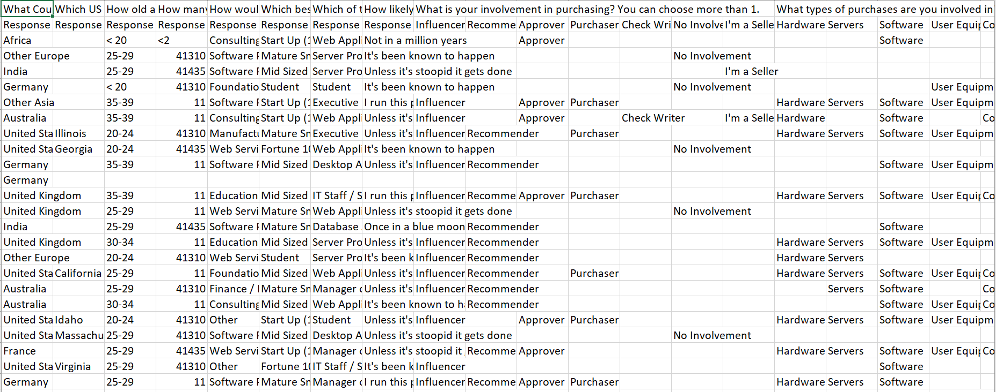
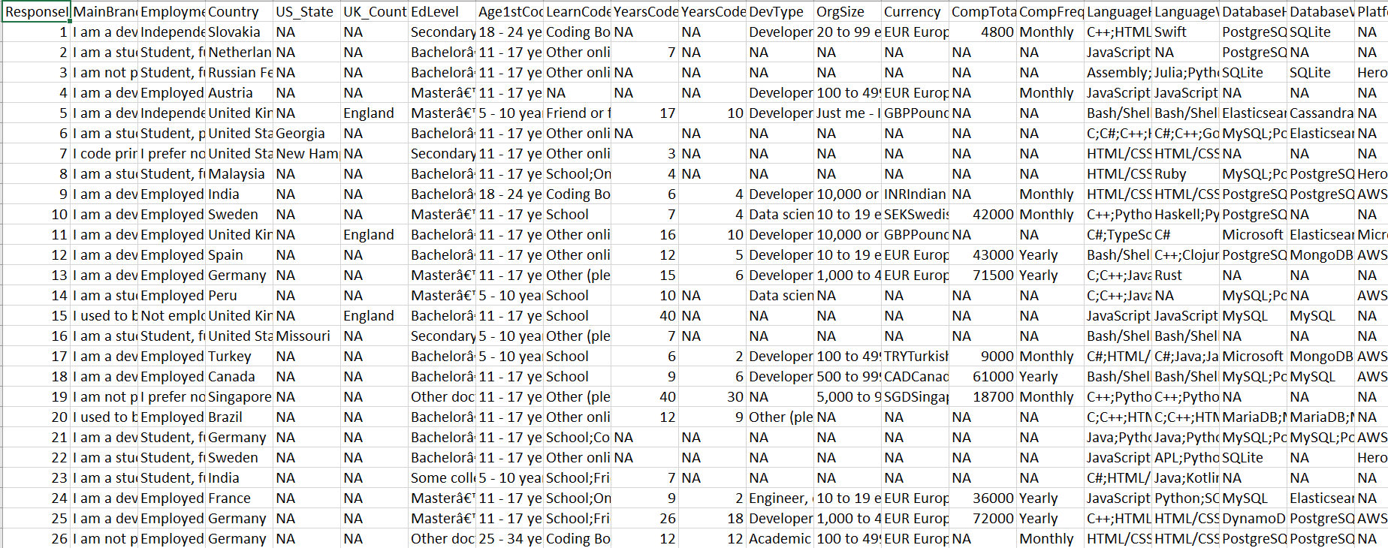
Annual Developer Salary + GDP per Capita
Publicly available data source from Stack Overflow
Annual survey administered to programmers, developers, data professionals
2011 – 2021 concise and normalised data
In the format of csv files
Notes:
Shilpa – to present the bullets denoted

Slide 10
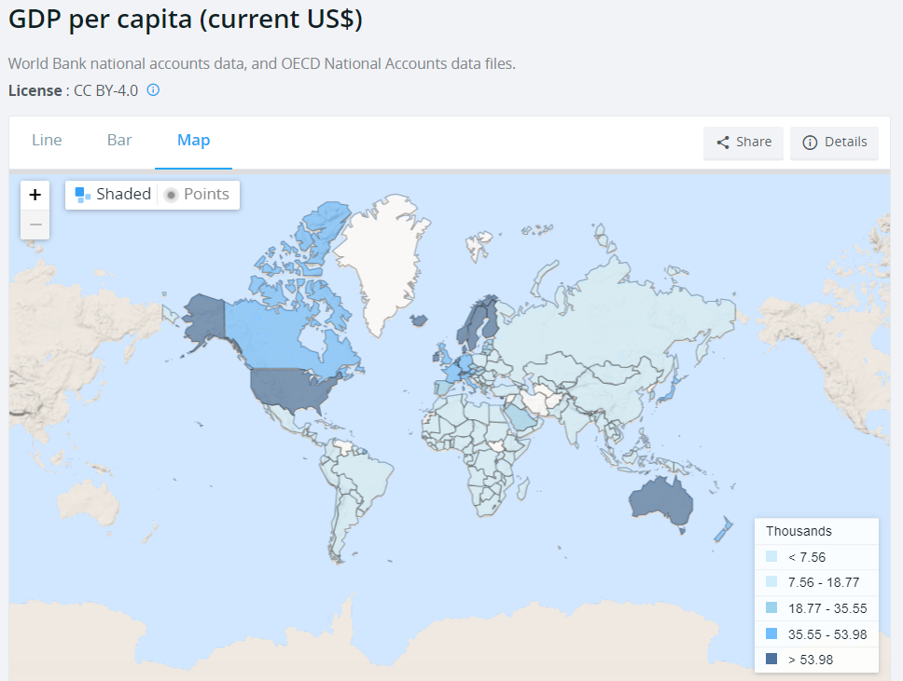
Supplementary Data
Incorporated GDP data per Capita which enriched our findings
Preview of GDP Data
Notes:
Kamil to add GDP context

Slide 11
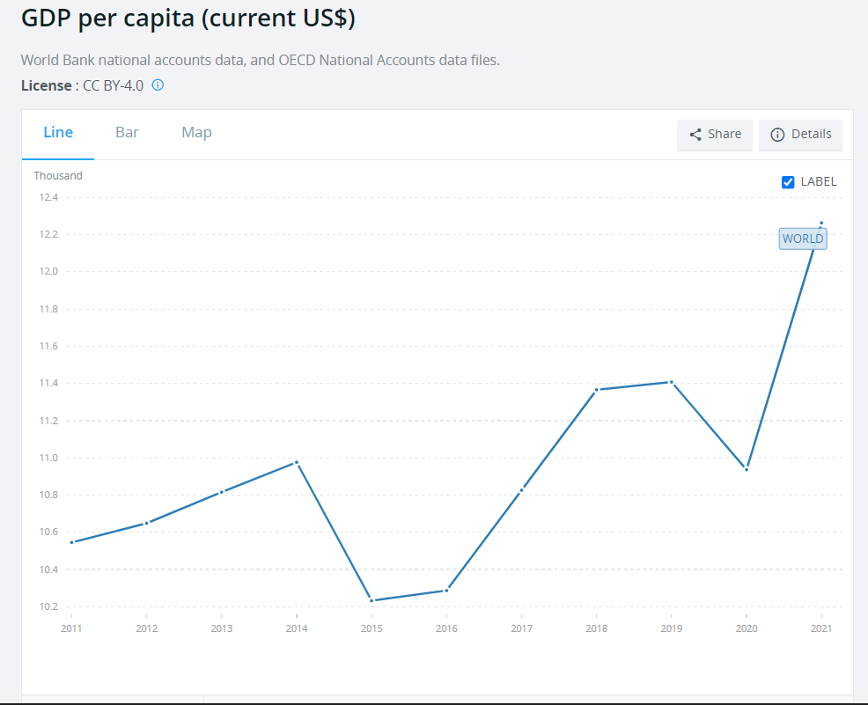
Supplementary Data
Preview of GDP Data from 2011 to 2021

Slide 12
Data Cleaning Process

Slide 13
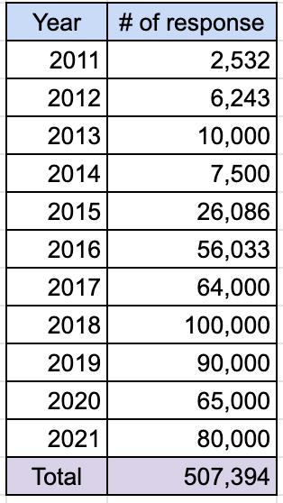
Why Data Cleaning?
Survey Questions were different every year
Inconsistency in data value range .
E.g Age is in the range of 20 to 25, 26 to 30 in 2014. Whereas in other years 22 to 24, 24 to 26 and so on
More data values categories in latest years
E.g New languages were added in latest years
Not every survey questions were answered by the respondents, had to deal with a lot of empty responses
Grouping of data input values
E.g Frontend dev occupation is same as web developer
Notes:
Shilpa – to present the bullets denoted

Slide 14
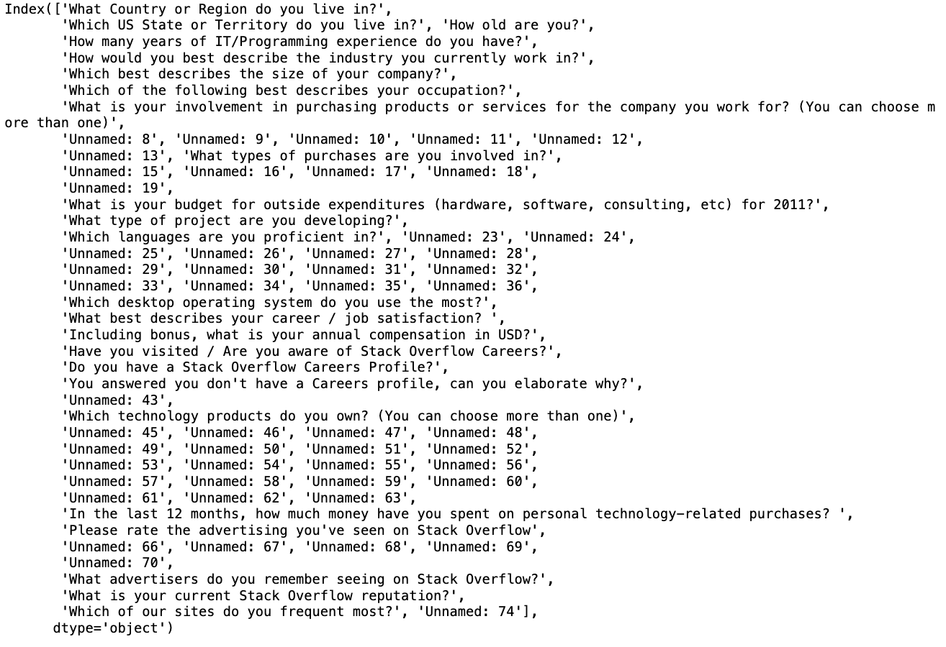
Data Cleaning Process
Initial Attribute List
country age IT_experience_in_years company_size occupation proficient_languages desktop_OS job_satisfaction compensation Gender industry current_development_project product_technology stackoverflow_reputation
Row Data Size (507349, 126)
Step 1: Mapped survey question to listed key attributes for every year
Notebook: https://github.gatech.edu/MGT-6203-Summer-2022-Canvas/Team-94/tree/main/salary_prediction_for_software_developers/Notebooks/data-extraction
Notes:
Shilpa – to present the bullets denoted

Slide 15
Data Cleaning Process
Initial Attribute List
country age IT_experience_in_years company_size occupation proficient_languages desktop_OS job_satisfaction compensation Gender industry current_development_project product_technology stackoverflow_reputation
Step 2: Merge the data across all years
Notebook: https://github.gatech.edu/MGT-6203-Summer-2022-Canvas/Team-94/blob/main/salary_prediction_for_software_developers/Notebooks/data-extraction/data-consolidator.ipynb
Attributes Verification
1. Country
- All the years has country information will be used as is
2. Age
- 2016 has both age rage and specific age value, since most of the years has rage retaining the range as the values
- 2017 has no age column will be imputed as number of years of experience+22 as 22 is the minimum age once attains after degree
3. IT_experience_in_years
- 2016 has both range and specific values, since most of the years has rage retaining the range as the values
4. Industry
- Is available only for 2011, 2012, 2013, 2014, 2015, 2016 (6 years) and missing in 5 years which would be hard to impute hence dropping this column
Notes:
Shilpa – to present the bullets denoted

Slide 16
Data Cleaning Process
Final Attribute List
GDP age IT_experience_in_years company_size occupation proficient_languages desktop_OS job_satisfaction gender compensation
Step 3: Normalizing individual attributes
Notebook: https://github.gatech.edu/MGT-6203-Summer-2022-Canvas/Team-94/tree/main/salary_prediction_for_software_developers/Notebooks/data-normalization
Step 4: Encoding of Normalized data for model development
Notebook: https://github.gatech.edu/MGT-6203-Summer-2022-Canvas/Team-94/blob/main/salary_prediction_for_software_developers/Notebooks/model_data_encoder.ipynb
Data Reduced to (252740, 61)
Notes:
Shilpa – to present the bullets denoted

Slide 17
Feature Engineering
Compensation
below-20000 20000-40000 40000-60000 60000-80000 80000-100000 100000-120000 120000-140000 140000-160000 above-160000
Using country attributes to fetch the GDP per capita – During modelling process data was scaled to have mean 0 and SD of 1 as most of the variables were one hot encoded
Gender information was not available for 2011, 2012 and 2013 – Imputed based on industry standards for the individual years
Compensation has both ranges and individual values – By analysis industry standards 9 categories were created
Notes:
Shilpa – to present the bullets denoted

Slide 18
Exploratory Data Analysis

Slide 19
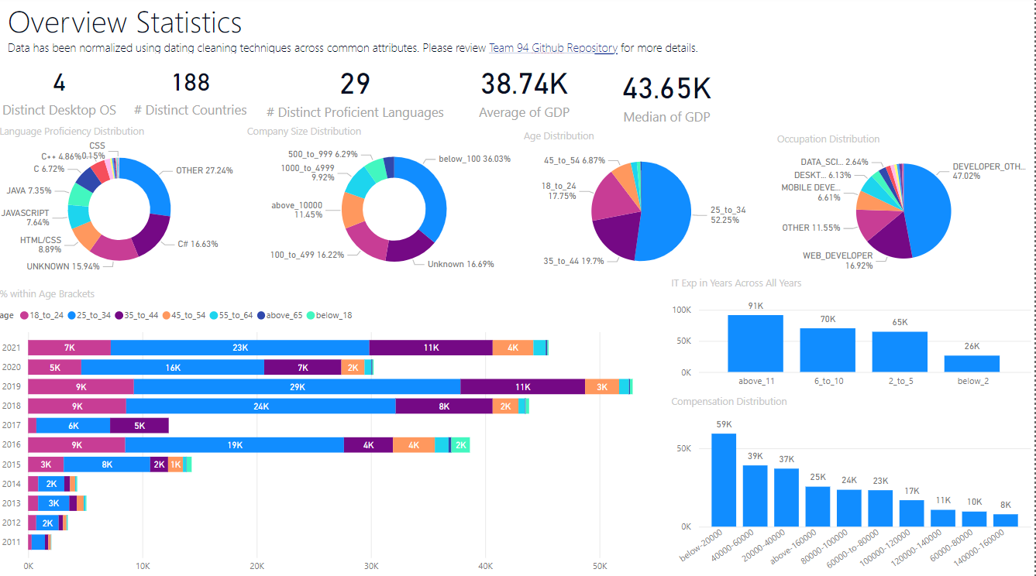
Exploratory Data Analysis

Slide 20

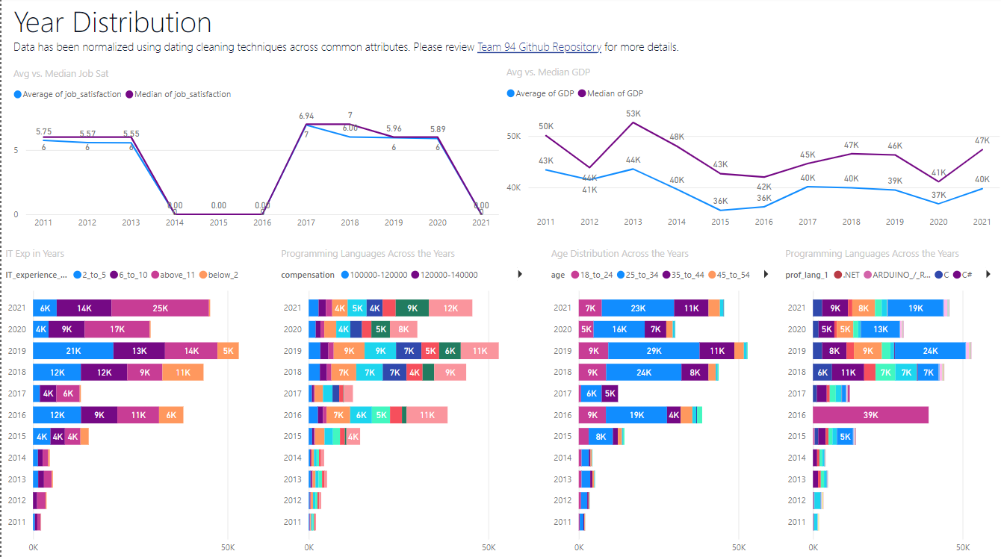
Exploratory Data Analysis

Slide 21
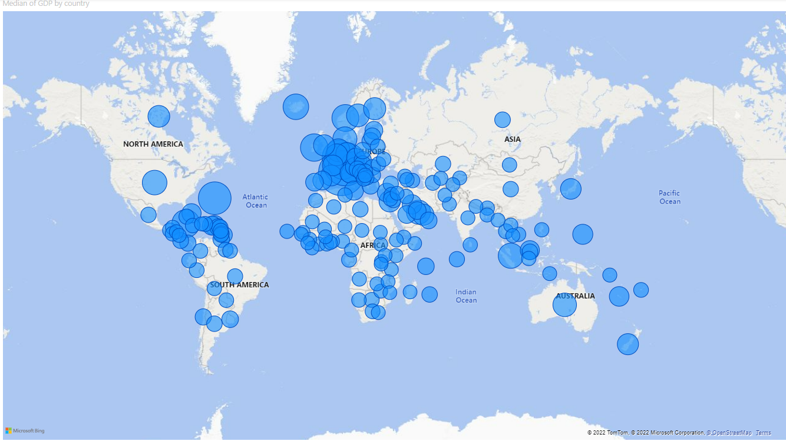
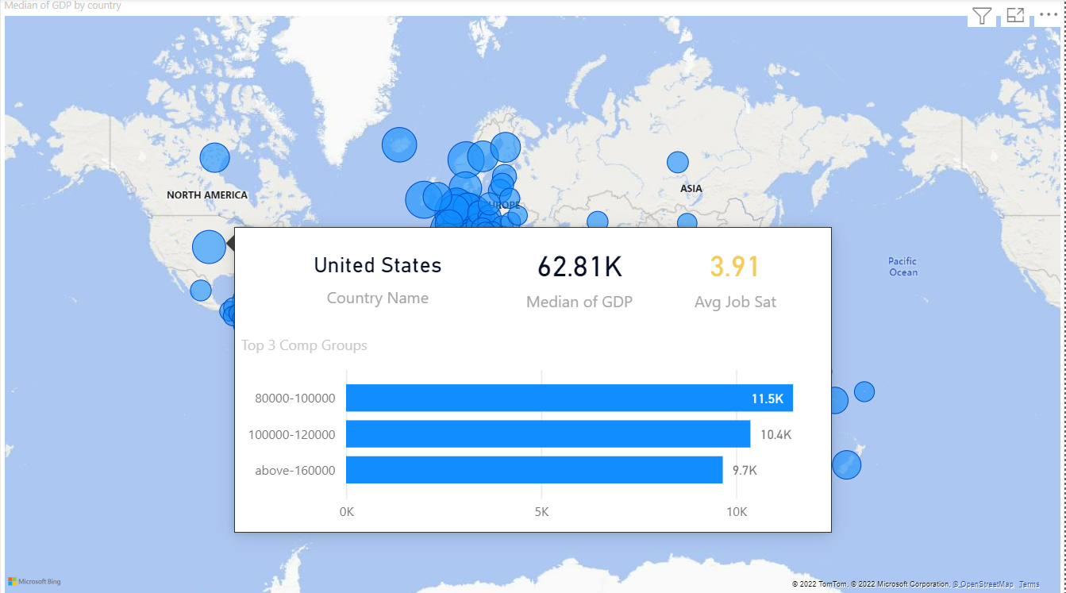
Exploratory Data Analysis

Slide 22
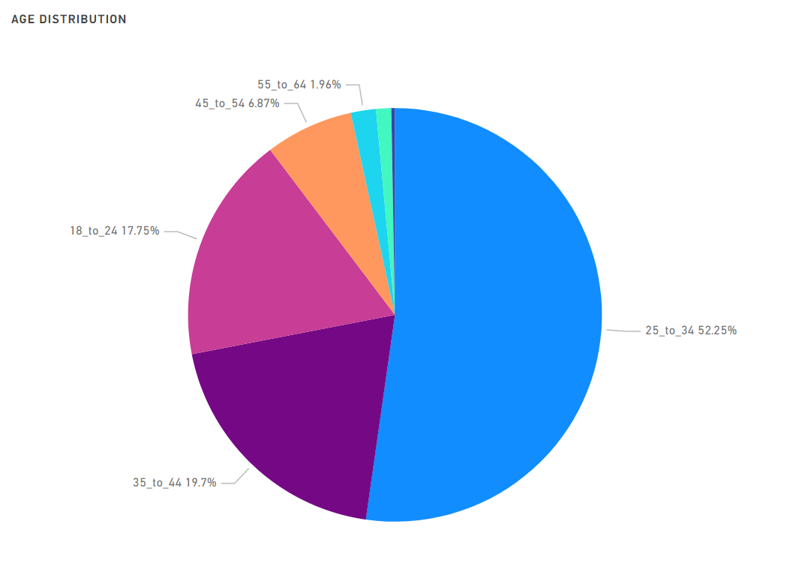
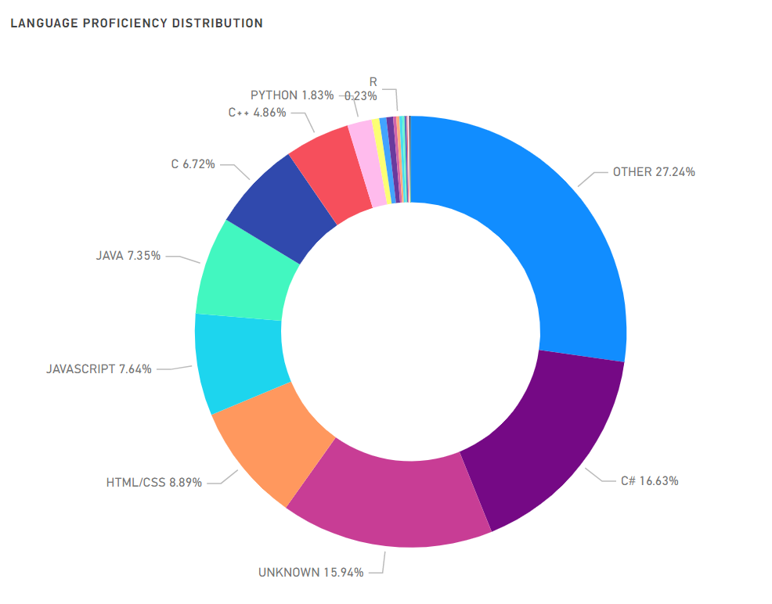
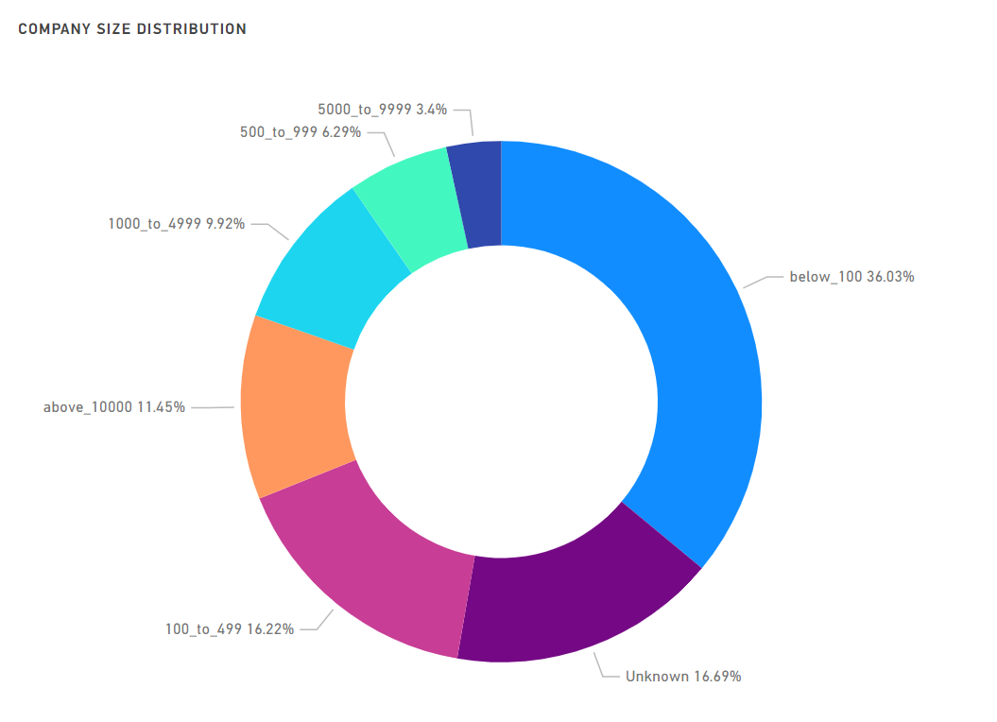
Key Insights – Descriptive Analytics

Slide 23
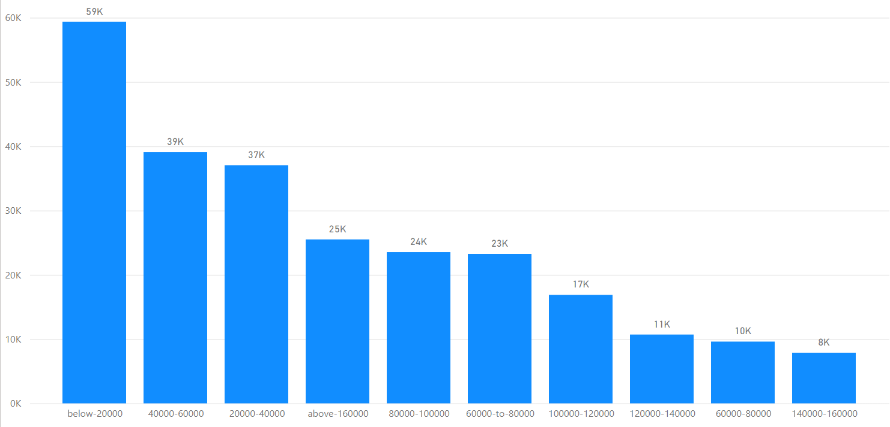
Compensation Distribution

Slide 24
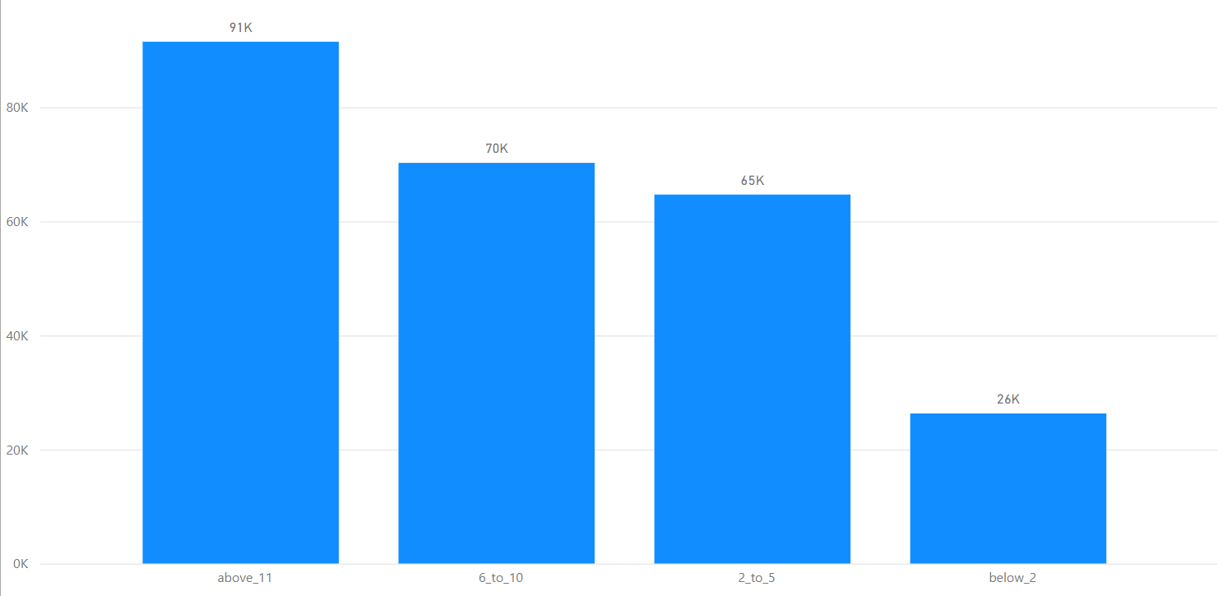
Distribution of IT experience

Slide 25
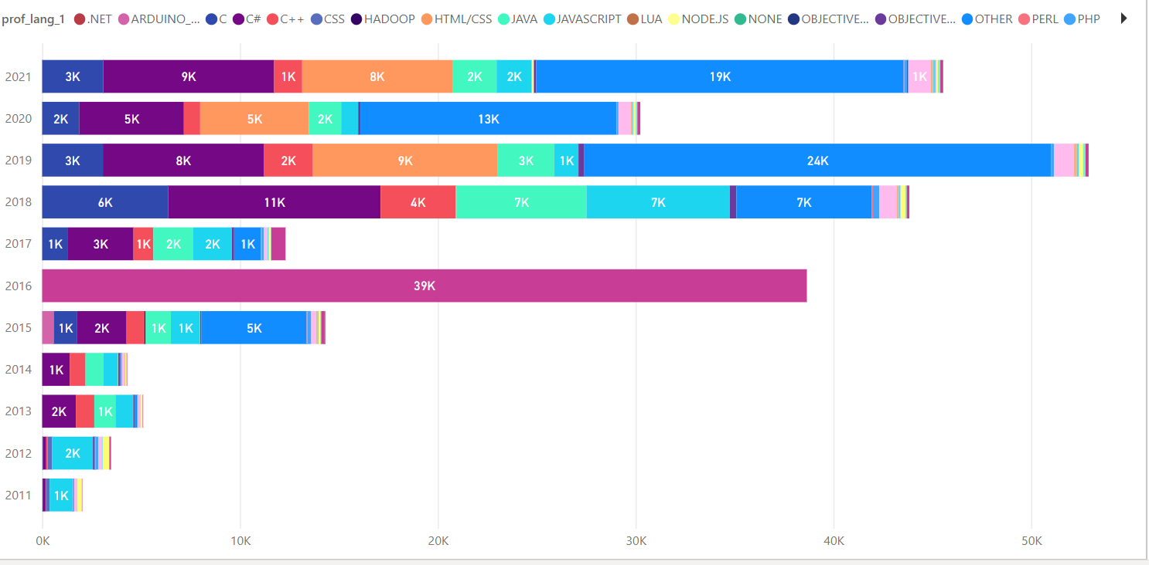
Proficient Languages

Slide 26
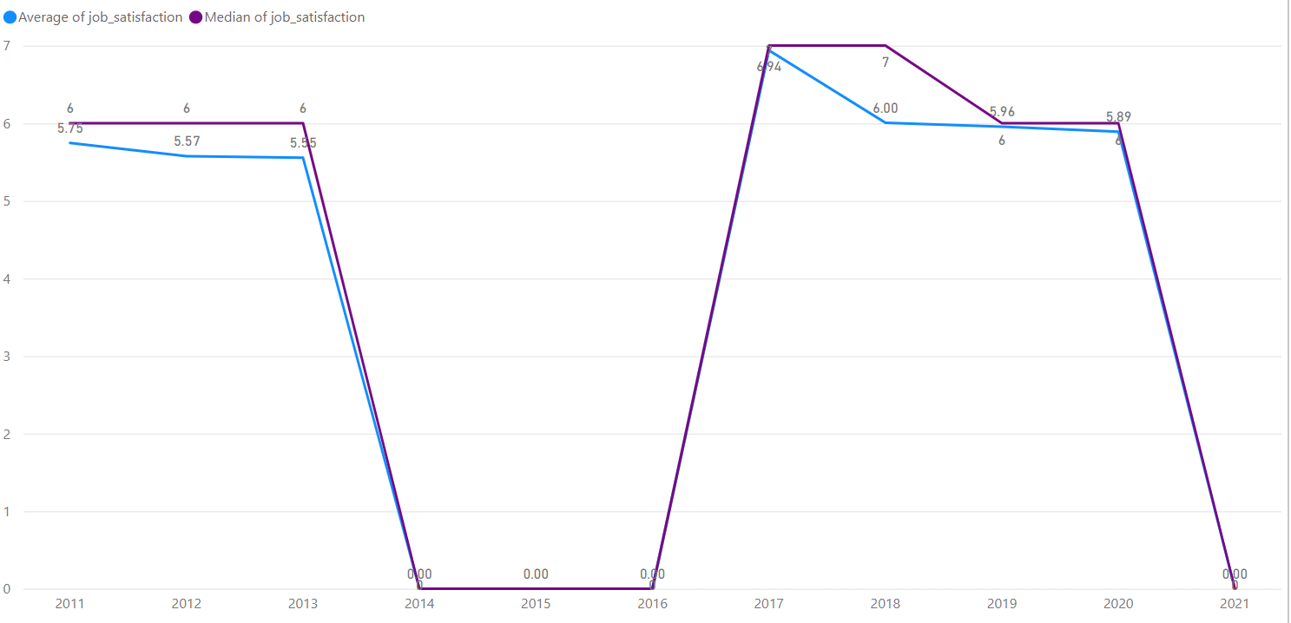
Distribution of Job Satisfaction

Slide 27
Modelling Overview
Notes:
Kamil to present

Slide 28

Models in Use
Random forests
Light gradient boosting machine
Multinomial logistic regression
Notes:
Tools used to analyse data include R, Python and Microsoft Power BI.
k-Nearest Neighbors, Decision Trees, Naive Bayes., Random Forest, Gradient Boosting,
Required questions addressed here:
What type of models did you use?
How did you perform model selection?
Why did you choose those models in particular?
Our modelling approach is based on ensemble models including light gradient boosting machine and random forests, as well as multinomial logistic regression. We selected ensemble models considering their potential to improve performance over a single estimator due to reduced variance, and logistic regression was used for comparison which, unlike linear regression, does not assume linearity or homoscedasticity.

Slide 29
Modelling Overview
Salary variable was treated as categorical or continuous (consecutive integers for ordered salary categories).
Hyper-parameter optimization:
For ensemble models:
Parameters controlling tree complexity: maximum tree depth, number of leaves and minimum data in a child leaf.
Bagging fraction.
Number of features at branching step (RFs).
Boosting learning rate, regularization (LGBM).
Multinomial logistic regression – regularization (generalization/complexity trade-off).
Model performance was evaluated mainly with the kappa metric in cross-validation and validation on test set.
Other evaluation metrics were also applied, e.g. accuracy, confusion matrix, ROC curves.
Notes:
Required questions addressed here:
How did you perform model selection?
How did you perform hyper-parameter optimization?
In this supervised learning task, salary is an ordinal variable and our modelling involved the treatment of this variable as categorical or continuous, followed by a comparison of model performance.
To tune model hyperparameters, model error was used to find optimal parameters controlling tree complexity for tree-based models. Further parameters to tune included the bagging fraction, number of features at a branching step for random forests and boosting learning rate for LGBM, as well as regularization for logistic regression.
Model performance was evaluated mainly with the kappa metric in cross-validation and validation on a test set.​ In this presentation only the kappa metric is reported. Other evaluation metrics such as accuracy, confusion matrix and ROC curves can be found in the report.

Slide 30
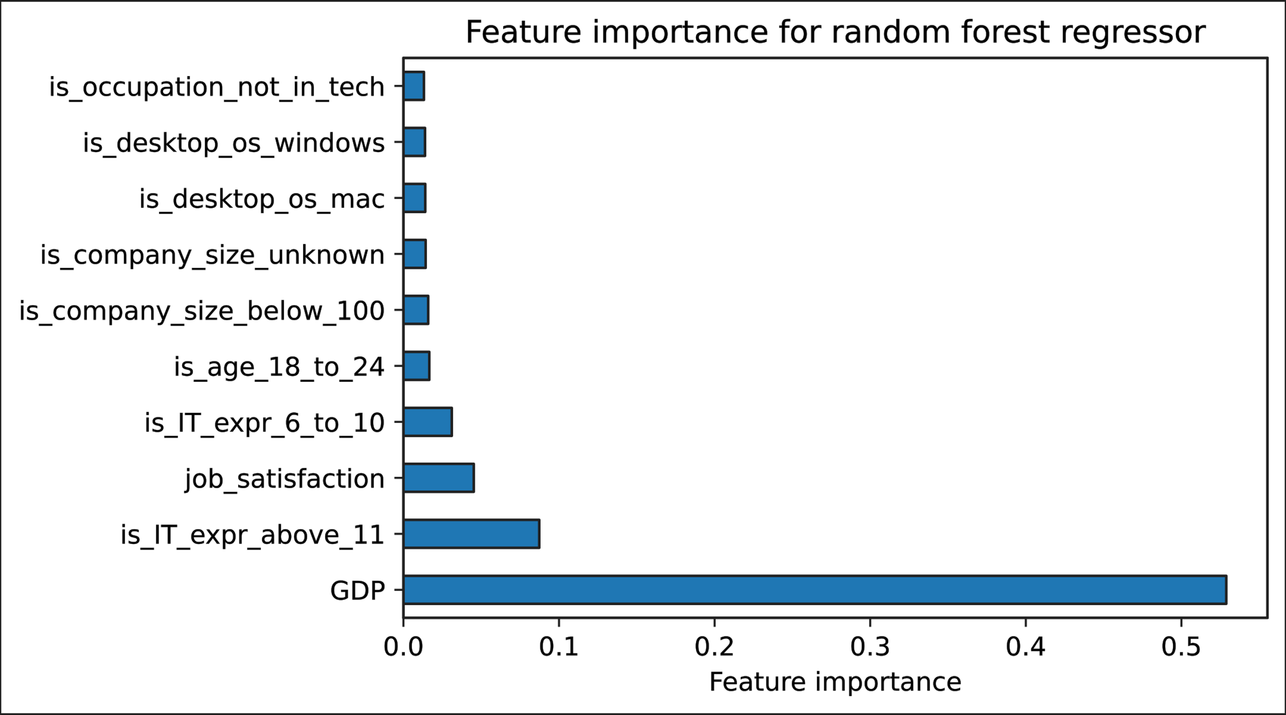
Modelling – Results
Typical range of kappa metric: 0 (random assignment) - 1 (perfect assignment).
Random forest regressor achieved the highest kappa scores at 0.713 (CV) and 0.717 (test set).
Overall, random forest and LGBM had similar performance.
Test set Kappa metric for multinomial logistic regression was 0.382.
Overall, regressors tend to have better performance than classification models:
For LGBM, the regressor is marginally better (kappa difference of 0.077).
In the case of RFs the difference is ~0.152 higher.
Variable importance measures for ensemble models indicate a strong influence of GDP, followed by factors related to e.g. IT experience and job satisfaction.
Notes:
Required questions addressed here:
How did the models perform generally speaking?
How do they compare?
Are they useful and in what ways?
The typical range of the kappa metric is between 0 and 1. We found that the random forest regressor achieved the highest kappa score of 0.68. Overall, random forests and LGBM had similar performance, while multinomial logistic regression had a kappa score of 0.35. Overall, regressors produced a better fit than classification models. The models are useful as they allow the interpretation of variable importance measures. We observed a strong influence of GDP on salary, followed by factors related to e.g. IT experience and job satisfaction.​

Slide 31
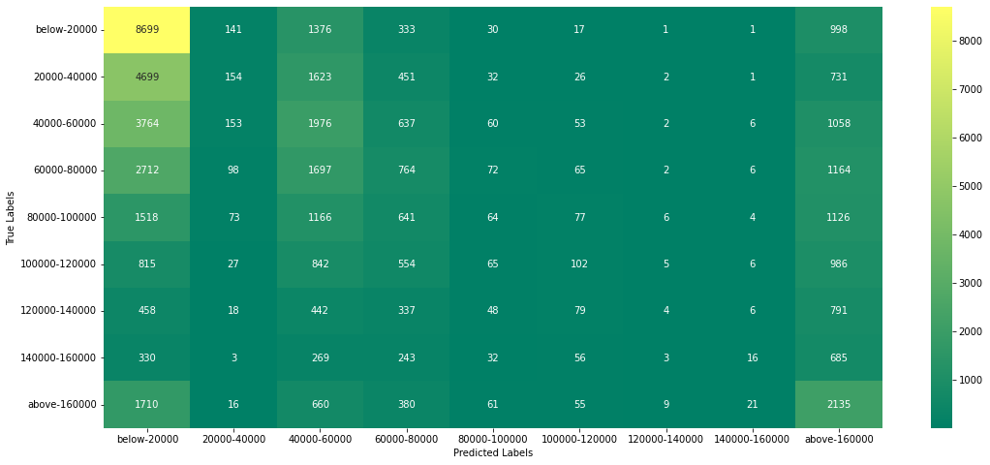
Logistic Regression Baseline Results
Metric | Value
Accuracy | 0.275
Macro averaged precision | 0.206
Macro averaged recall | 0.180
Macro averaged F1 | 0.275
Kappa | 0.35
Notes:
Actuarial Research Paper to Understand Approach for Salary Prediction

Slide 32
Challenges
Notes:
Neema: presenting on challenges

Slide 33
Challenges
Data Cleansing
Null Handling – Non-Response Bias
Multi-Select Survey Responses
Missing questions
Inconsistent data type for responses of the same questions across different years
Modelling
Having to treat a response variable that has an underlying continuous data generating process as a multinomial classification problem due to data quality issues
Analysis
Very different salary levels in different countries makes GDP an important variable. Its importance is however irrelevant for answering our hypothesis
Notes:
Null handling – in some instance we dropped NA or null data where appropriate
Filtered out where compensation was not recorded, this could be investigated further
Multi-select survey responses, I.e. proficient languages we only looked at the first selected language, as well as occupation, only taking the first selected occupation

Slide 34
Key Outcomes

Slide 35
Analysis of Modelling: Was our hypothesis correct?
Data quality issues made it reasonable to investigate the problem with a multinomial classification model
This type of modelling require nuanced, sophisticated, and less intuitive interpretation of the results
A kappa score of 0.68 suggest a moderate level of agreement. I.e a decent, but far from great model *
The current dataset and model can be useful as a starting point, but does not today give sufficient results to be used for the projects outlined use-cases
The only data we collected from another source, GDP, had by far the largest variable importance. Suggesting adding and adjusting for more contextual data for each respondent will be sensible addition
Notes:
Source for Kappa score: https://www.ncbi.nlm.nih.gov/pmc/articles/PMC3900052/

Slide 36
Future Iterations
Time Series Analysis
Add and adjust for more contextual data
Create continuous variable of Salary in order to enrich our prediction models
Work From Home Analysis from recent survey data
Tuning Models
Data Wrangling
Notes:
Tuning of the models
Data wrangling (I.e. prof lang, occupation, grouping techniques, null handling)

Slide 37
Supplementary Findings + Research Papers
Study by Martin et al. (2018) explored salary prediction for IT workers based on job offers from a Spanish IT recruitment portal.
Their ensemble models achieved ~84% accuracy.
Workers could be clustered based on skillset.
Experience was more rewarded than education
Work by Barrero et al. (2021) indicates the expectation of lasting impact of the COVID-19 pandemic on work from home (WFH).
Estimated 20% of workdays are expected to be WFH.
Less company spending (e.g. office space) and reported productivity boost due to WFH are likely to impact salary changes but the exact effect is unknown.
Notes:
Actuarial Research Paper to Understand Approach for Salary Prediction

Slide 38
Appendix
How much of Salary varies in future by n steps
Inflation Data
Global Inflation Pew Research
https://data.worldbank.org/indicator/NY.GDP.PCAP.CD
https://www.ncbi.nlm.nih.gov/pmc/articles/PMC3900052/
Data Analysis Stack Overflow
https://simonhessner.de/why-are-precision-recall-and-f1-score-equal-when-using-micro-averaging-in-a-multi-class-problem/

Slide 39

Thank You!

